Slide 1
Team 2 Inwood Bagels Class Presentation
Gaëlle Gilles – Project Manager/Lead Developer
Noah Poticiello – Database Analyst
Hemaswi Gorrela – Developer
Charles Adams Product Owner
Brindavani Pathuri – Tester
Nandu Devarasetty – Lead Business Analyst
Abhilash Gubbala – QA Analyst

Slide 2
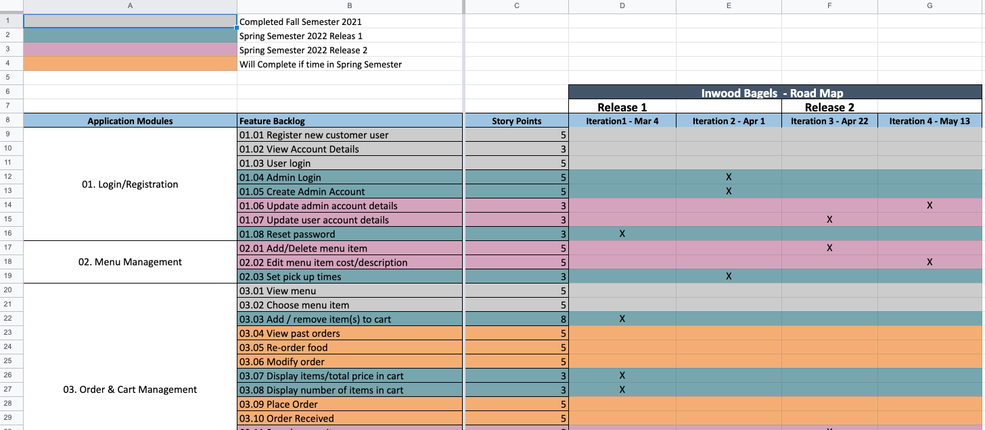
Road Map
Presented By Gaëlle Gilles

Slide 3
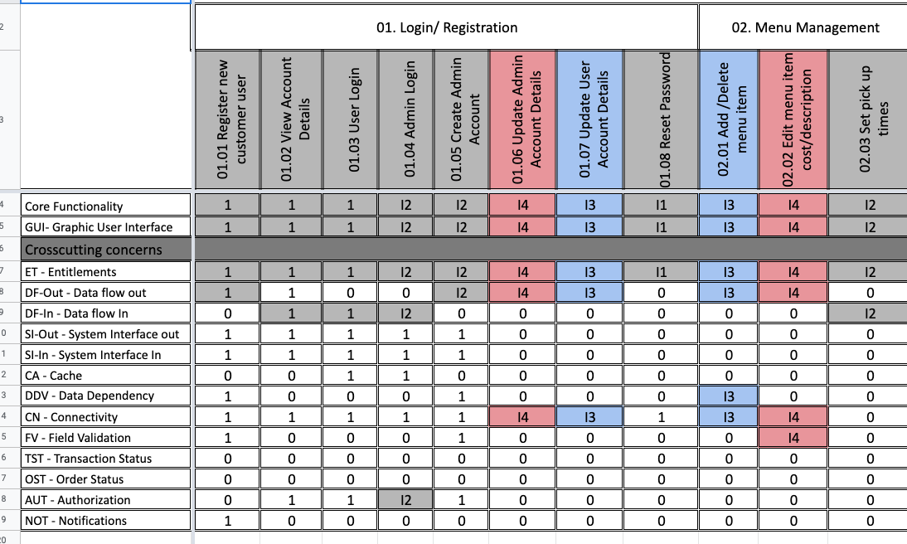
Requirement Composition Table (RCT)
Presented by Nandu Devarasetty

Slide 4
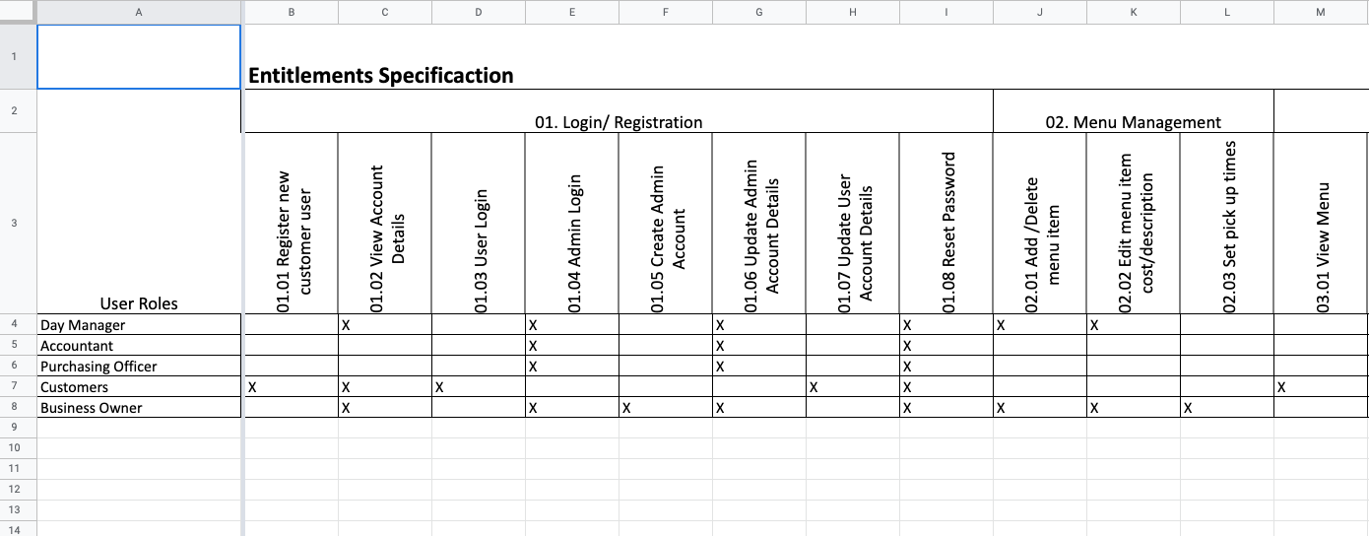
Actors Specification (ET Tab in RCT)
Presented by Nandu Devarasetty

Slide 5
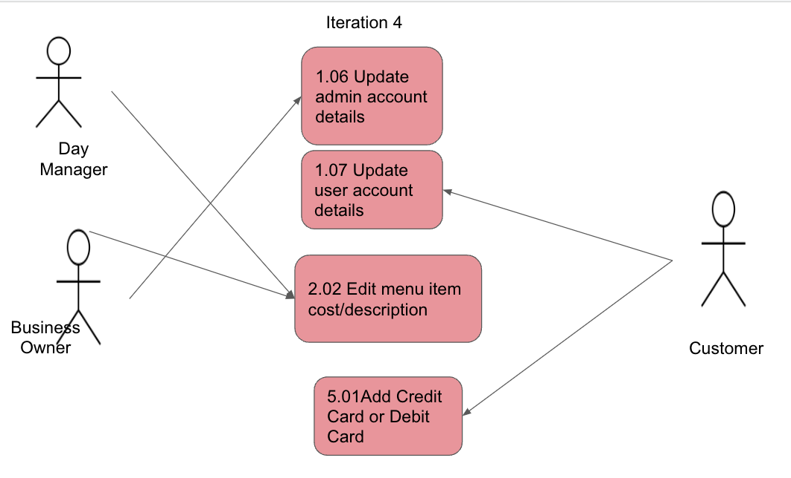
Use Case Diagrams
Presented by Charles Adams

Slide 6
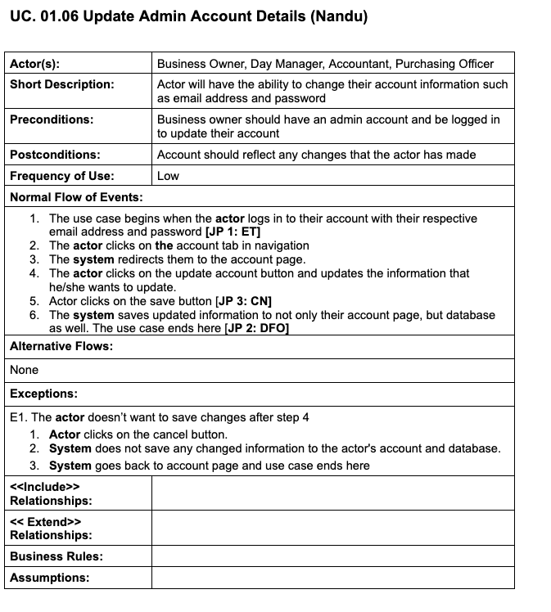
01.07 Update Admin Account Use Case Specification
Presented by Noah Ponticiello

Slide 7
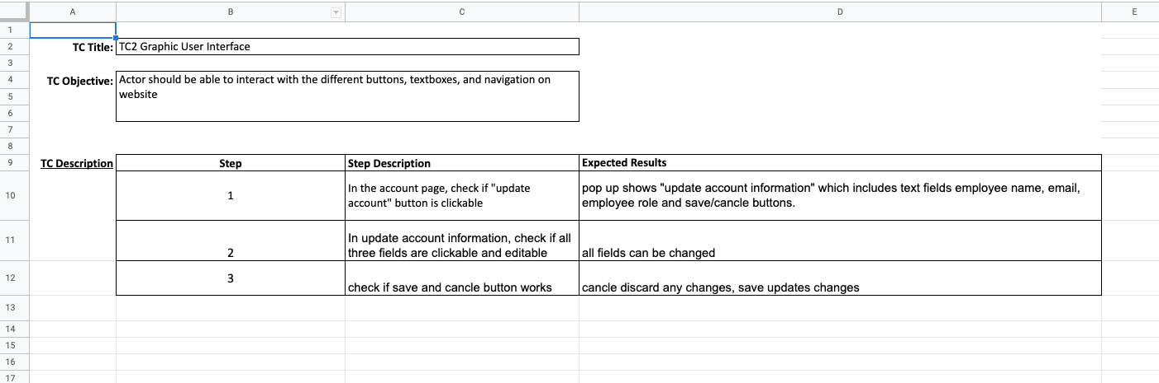
01.07 Update Admin Account Test Design
Presented By Abhilash Gubbala

Slide 8
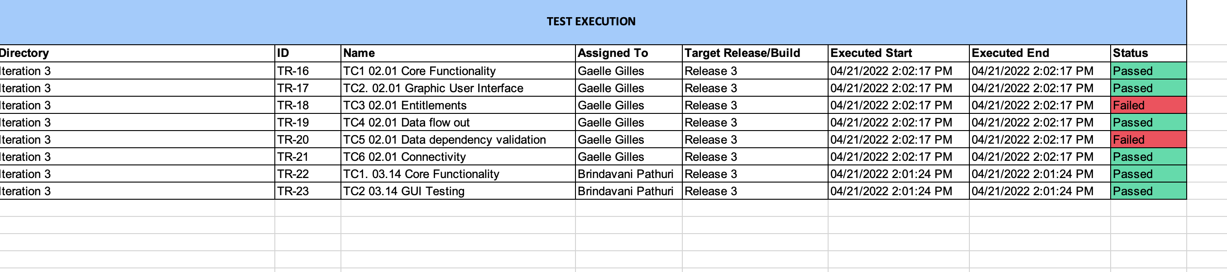
Test Execution Log
Presented By Brindavani Pathuri

Slide 9
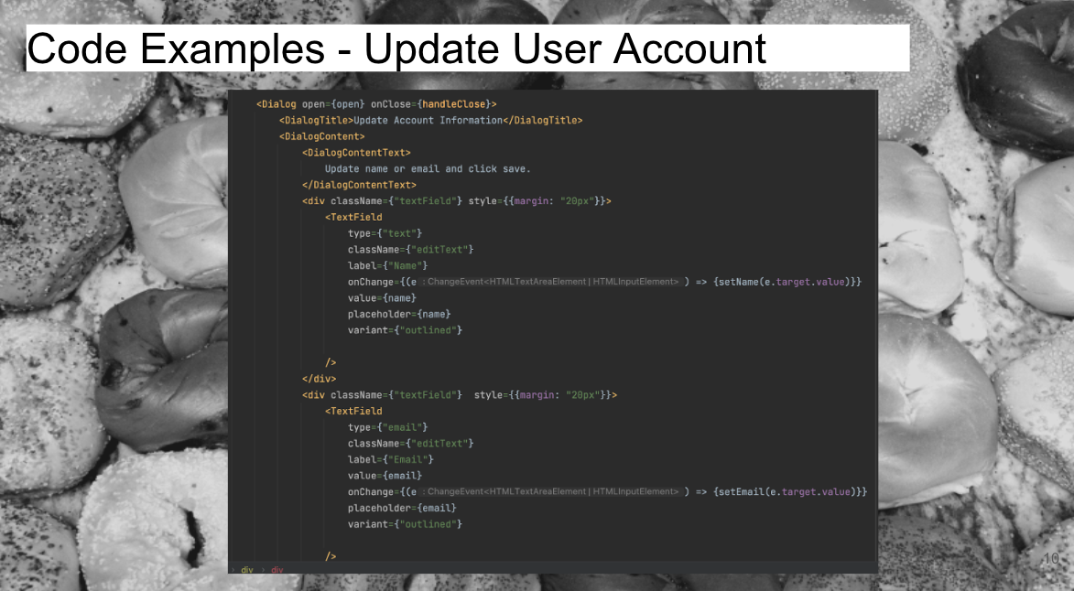
GitHub PowerPoint
Presented By Hemaswi Gorrela

Slide 10
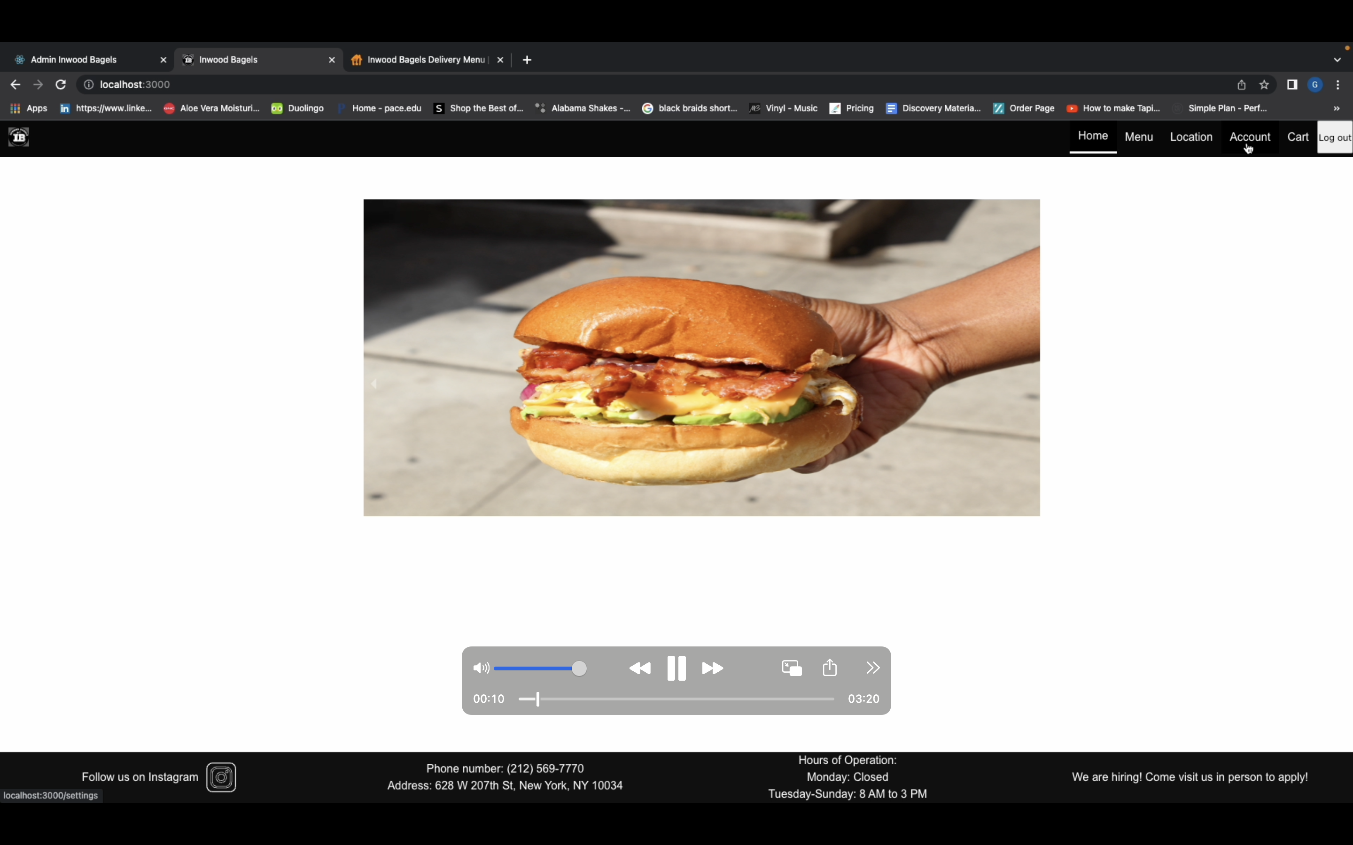
Application Demo
Presented By Gaëlle Gilles

